Slide 1
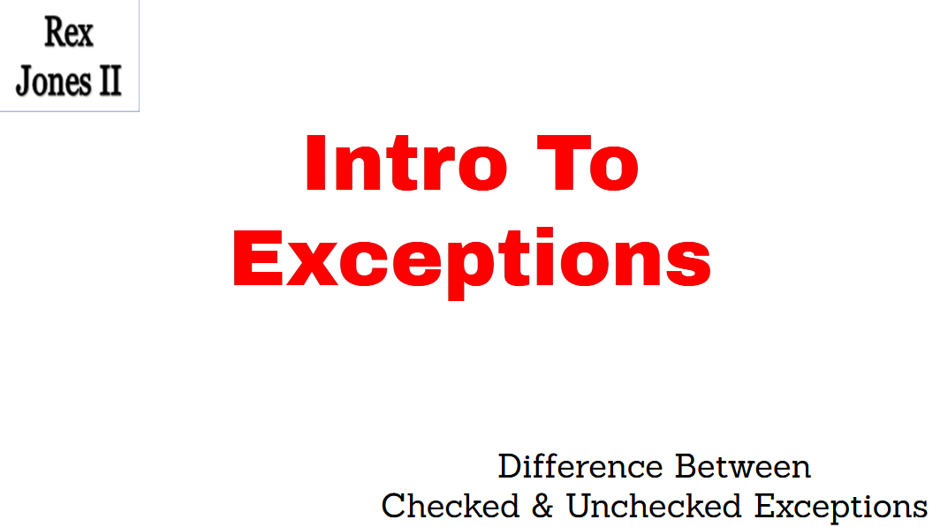

Slide 2
Intro To Exceptions
(Checked & Unchecked)
Trainer: Rex Jones II

Slide 3

Video Tutorial Plan
Checked & Unchecked Exceptions
4 Common Selenium Exceptions
How To Handle Exceptions
Rex Jones II

Slide 4
Exception Hierarchy
Throwable
Error
Exception
Rex Jones II

Slide 5
Exception Hierarchy
Exception
Checked
Unchecked
ClassNotFound Exception
Arithmetic Exception
IllegalAccess Exception
IndexOutOfBounds Exception
NoSuchField Exception
NullPointer Exception
Rex Jones II

Slide 6
Checked Exceptions
Exception https://docs.oracle.com/en/java/javase/13/docs/api/java.base/java/lang/Exception.html
ClassNotFoundException
CloneNotSupportedException
IllegalAccessException
InstantiationException
InterruptedException
NoSuchFieldException
NoSuchMethodException
ReflectiveOperationException
Rex Jones II

Slide 7
Unchecked Exceptions
Exception https://docs.oracle.com/en/java/javase/13/docs/api/java.base/java/lang/Exception.html
ArithmeticException | IndexOutOfBoundsException
ArrayIndexOutOfBoundsException | NegativeArraySizeException
ArrayStoreException | NullPointerException
ClassCastException | NumberFormatException
EnumConstantNotPresentException | SecurityException
IllegalArgumentException | StringIndexOutOfBoundsException
IllegalMonitorStateException | TypeNotPresentException
IllegalStateException | UnsupportedOperationException
IllegalThreadStateException | WebServiceException
Rex Jones II

Slide 8
Video Tutorial Plan
Checked & Unchecked Exceptions
4 Common Selenium Exceptions
How To Handle Exceptions
Rex Jones II

